Slide 1

Introduction to Wine Tasting
John Alexandre Weilenmann
B.Eng. Bioresource
M.Sc. Thesis Candidate Bioresource
Notes:
Hello everyone my name is John and today I will be introducing you to the very basics of wine tasting, I will try and compact 5 years of training into 5 minutes to try and prepare you for my favourite part of being a bioresource engineer , and that is realizing that alcohol is a prominent biological resource !

Slide 2
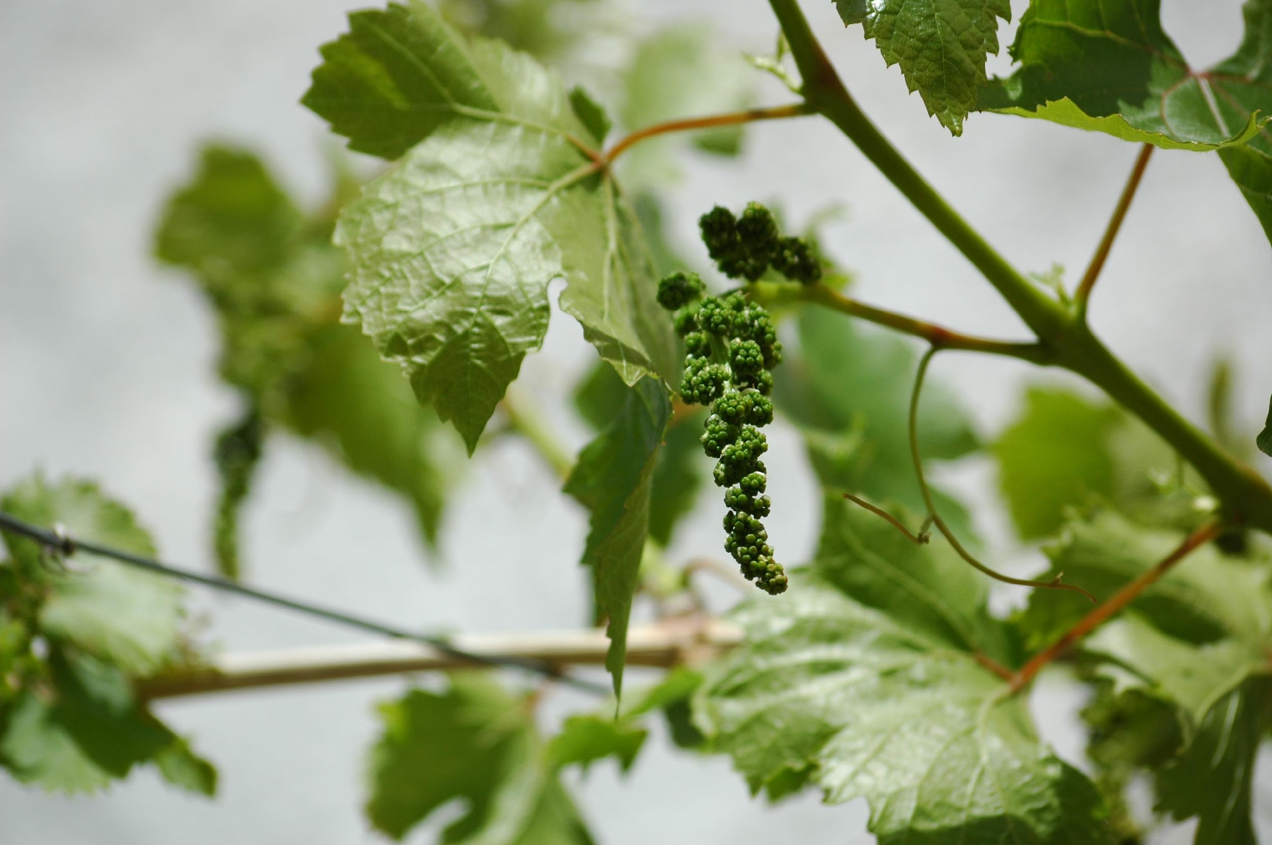
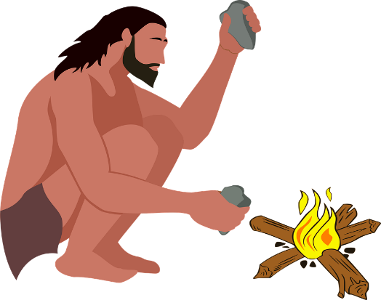
What Is Wine?
Wine is an alcoholic beverage made from fermenting grapes
Vitis Vinifera the original grape vine
Grape wines are woody perennial plants that produce sweet/tart grapes depending on climate
Wine grapes much smaller and sweeter then table grapes
Fun fact!
Wine was first used by humans in the Caucasus region 10000 years ago!!

Slide 3
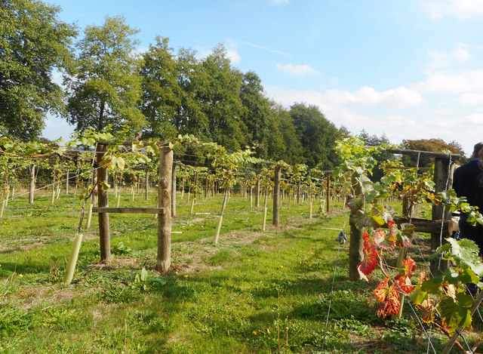

What makes up wine?
Water
Ethanol
Acids : Tartaric, Malic, Citric…
Amino Acids
Esters
Minerals: Ca, Mg, Na, Fe
Phenols: Tannins, anthocyanins, flavanols
Sugar
Acetaldehyde
Glycerol
Sulfites
Fun fact!
The American Dietary Guidelines state that 15 drinks a week for men and 8 drinks a week for women is what constitutes heavy drinking, below that your enzymes do most of the work!

Slide 4
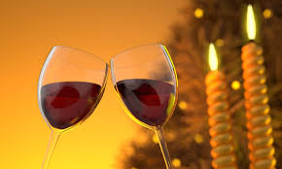

Wine Traits: Body
Combination of Tannins, Sweetness, Acidity, Alcohol and Carbonation
Tannin +
Sweetness +
Acidity –
Alcohol Content +
Carbonation –
Fun fact!
An example of comparing a light-bodied beer to a full-bodied beer would be like comparing a Coors Light to a Guinness! Notice how one gives a very unsatisfying experience whereas the other rolls off the tongue.
Notes:
The body of the wine is an expression of the other pieces of the wine puzzle, can be described as light to full body. An example of this wouldk be comparing 2% milk to skim milk. Whne swirling the 2% milk inside of the mouth there is a certain weight to it. Red wines will always be more full bodied compared to white wines , as they have much more tannins. An example of a full bodied wine woudl be a Syrah, whereas a light bodied wine would be a Pinot Noir.

Slide 5
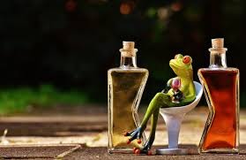
Wine Traits: Sweetness
Residual sugars from wine
Yeast attenuation factor
Classifications
Bone-Dry
Dry
Off-Dry
Medium Sweet
Sweet
Fun fact!
Human are bad at tasting true sugar content, acidity and carbonation reduce are ability to detect it in a liquid.
Notes:
The residual sugars are caused from sugars that are unfermentable from the yeast, this is usually due to the yeast strain dying from the alcohol at a range of 12-15% depending on the strain. The yeast attenuation factor tells the % of sugars the yeast is able to ferment before dying off. If wine is left exposed to air wild yeast may enter and increase the fermentation of the sugars to higher a alchol %
An example of a sweet wine would be a port

Slide 6
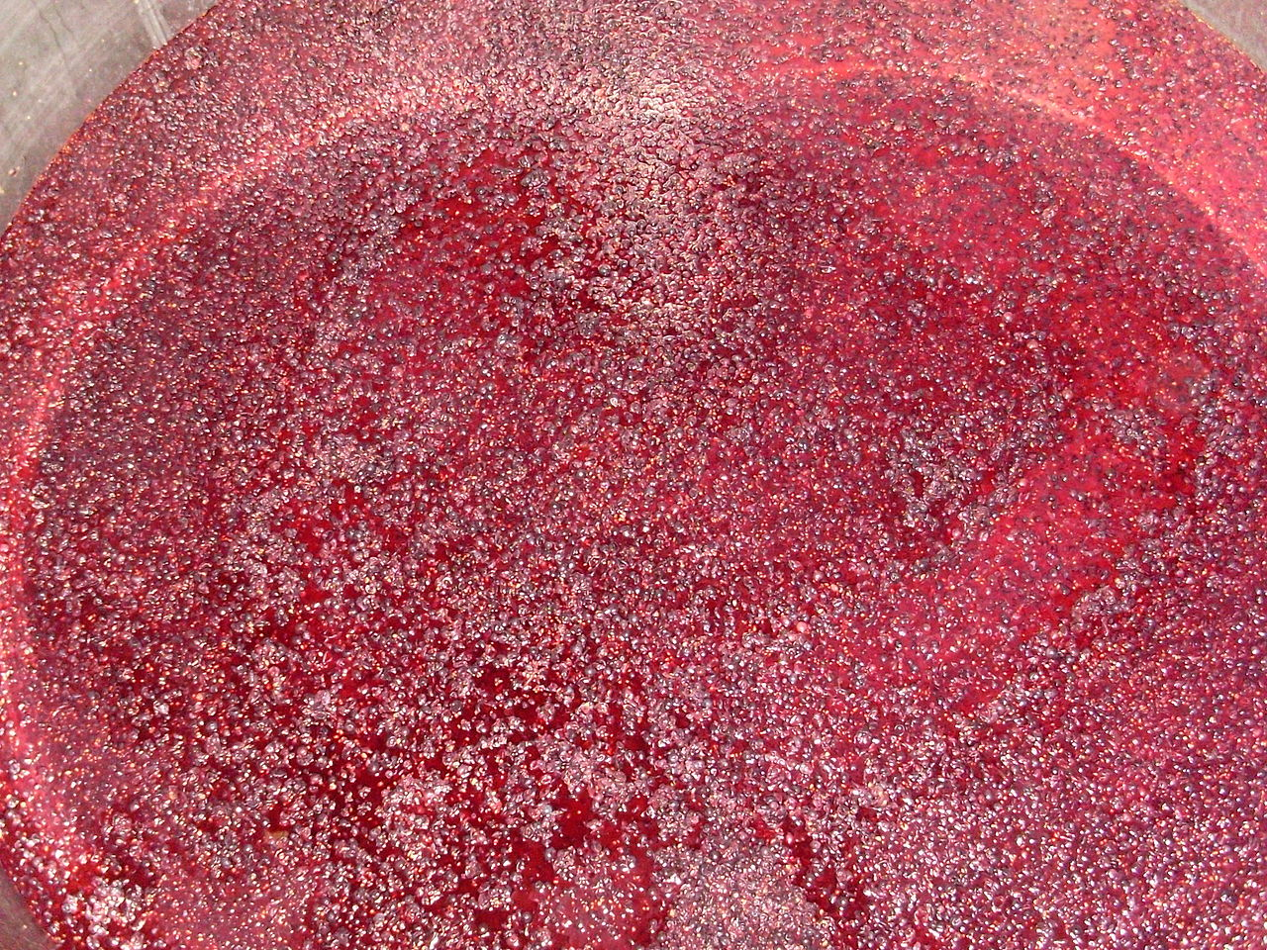
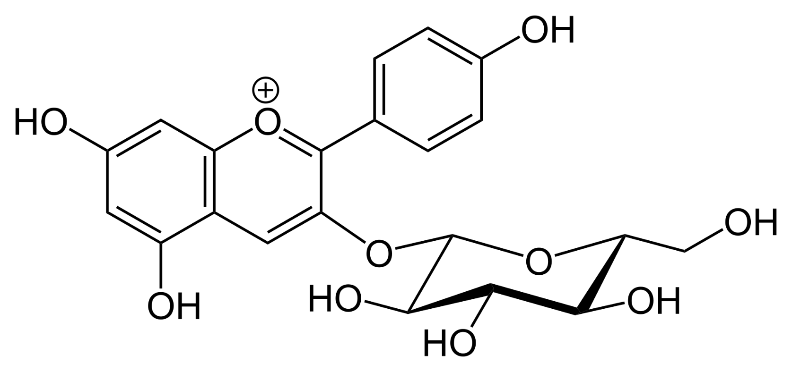
Wine Traits: Tannins
Polyphenols
Catechin, Gallic Acid, Quercetin
Inhibit cholesterol
Antioxidants
Bitter
Astringent
Intensity
Length
Callistephin: Found in Pinot Noir and Cabernet Sauvignon
Fun fact!
The healthiest wine you can buy is a young red wine as it still has most of the tannins present!
Notes:
Tannins are found in the plants leaves, seeds , fruit skin, they help stabilize the wine by protecting it from oxidation. Tannins provide a very astringent flavour, imagine leaving a package of green tea steeping for 30 minutes, after taking a sip you notice its very bitter/ astringent and your teeth feel gritty and dry.

Slide 7
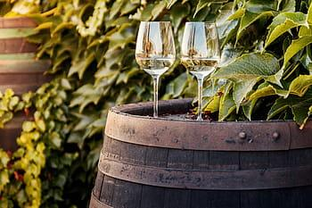
Wine Traits: Acidity
pH range 3-4
Hot regions –acid,
Cold regions + acid
4-12% total acids
High acidity: zesty, bright, tart, fresh
Low acidity: soft, dull, flat.
More acidity more stability!
Fun fact!
Fun fact our taste receptors perceive hydrogen ions as the sour flavor.
Notes:
The ph of wine ranges 3-4 but some cab be as low as 2.6 (whites) and some reds as high as 4.5
The hotter the region the less acidic, as wines ripen a lot faster.
Wines have a huge range of acid concentration
Here are some words for describing wine.
Malic acid like apple, tartaric acid like banna, citric acid like lemon

Slide 8
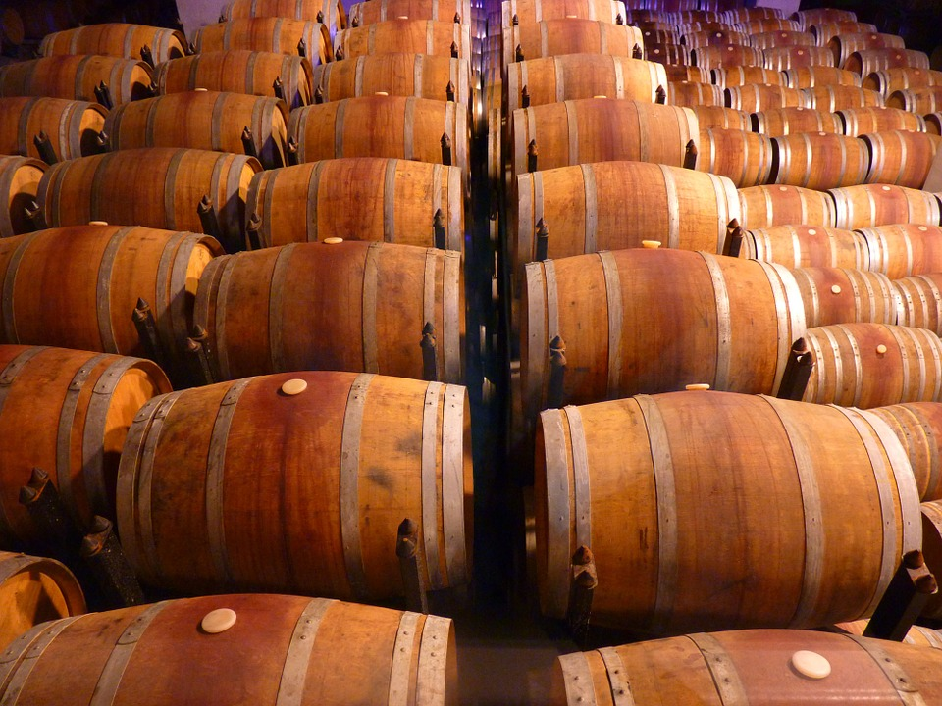
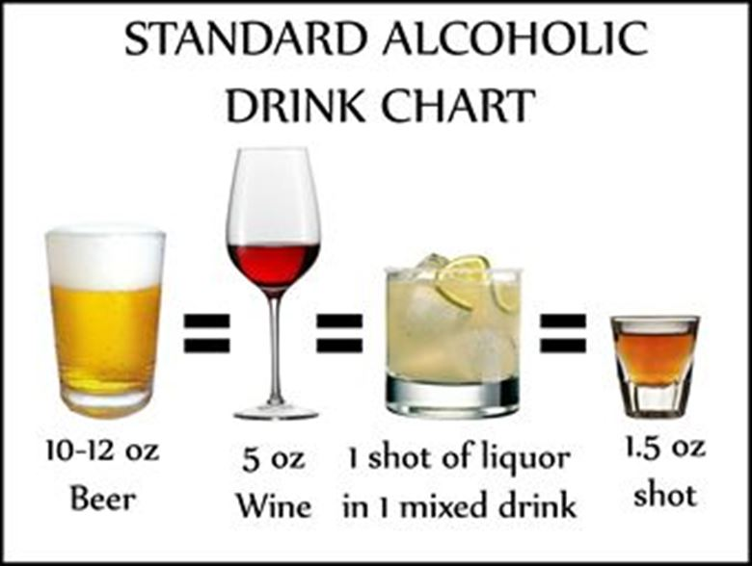
Wine Traits: Alcohol
Alcohol tastes like
Sweet
Spicy
Oily
+Alcohol + Viscosity
Grape sweetness = Alcohol
Fun fact!
Wine tears give an indicator of the sugar and alcohol content before !
Notes:
Alcohol can be perceived in different ways on our taste receptors thanks to our genetics, different people taste alcohol differently. People of east Asian descent and native American descent do not have as many ethanol processing enzymes , therefore they feel like effects of alcohol much faster. Indications of this our red in the face and a headache. Men generally have twice the amount of ethanol processing enzymes then women.

Slide 9
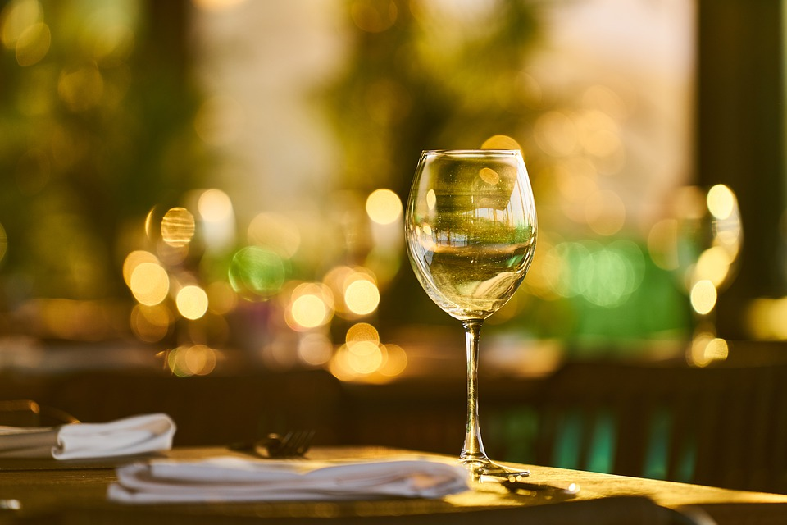
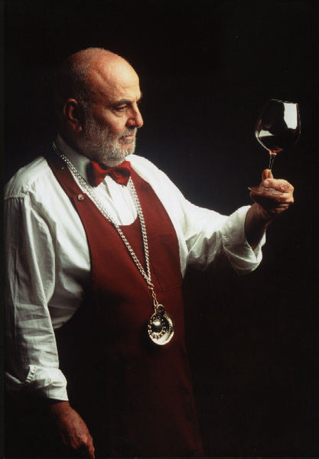
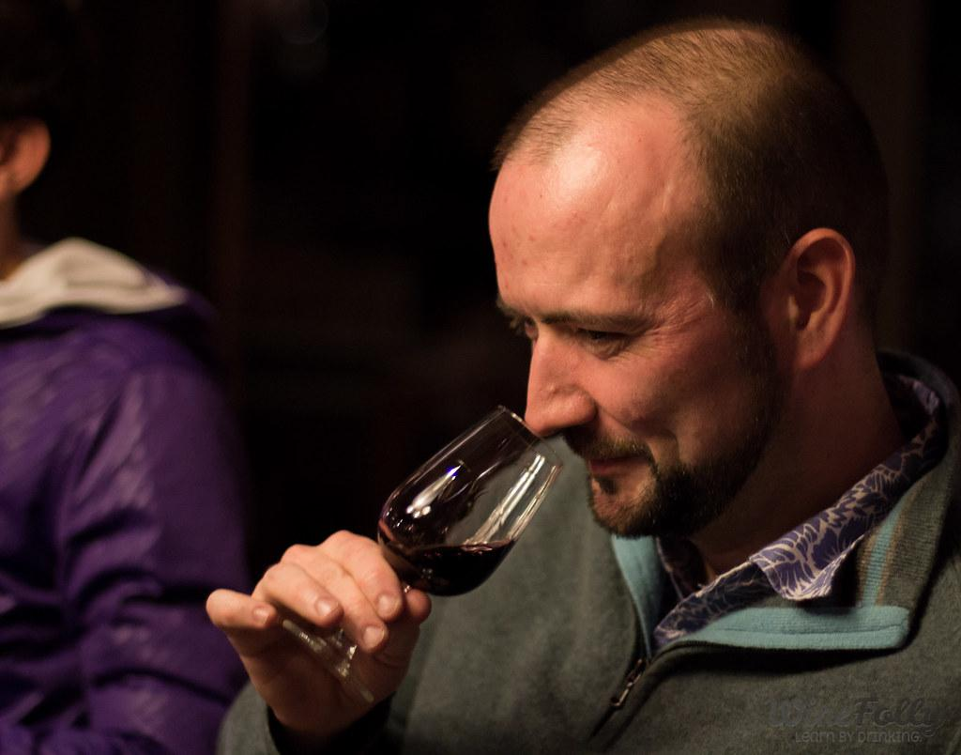
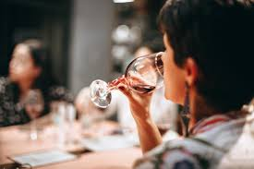
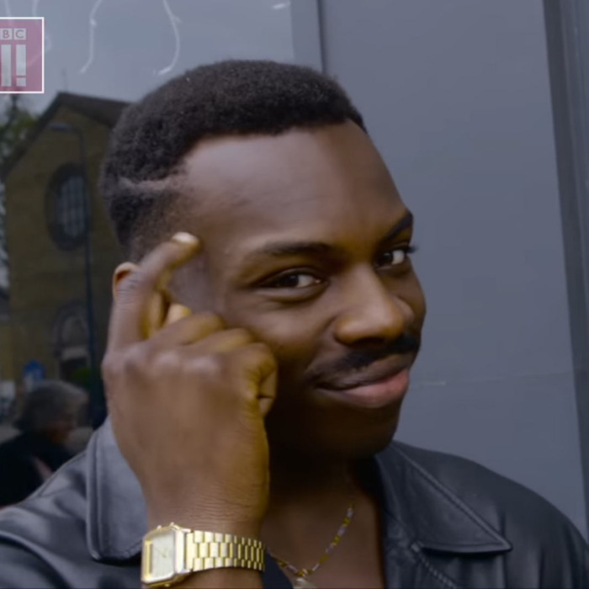
Wine Time
Look
Hue
Colour Intensity
Viscosity
Smell
1-3 Fruits
1-3 Herbs & Spices
Oak & Earth
Taste
Wine Structure
Flavours
Balance
Think
Rate
Write
Compare
Fun fact! Repeat these steps until you are unable to do step four for the ultimate wine tasting experience!
Notes:
Swirl the glass around and look at the wines hue, age is indicated for whites from straw to amber for age, pruple ot tawny for reds. Deeper colour more aged. Red colour basic, purple colour acidic, Look at wien tears for viscosity
Smell: Try and identify fruits like , strawberry, black currant, cherry,. Try to identify herbs and spices, like cinamon, pepper, fennel. Try and idntify oak scents like vanilla, chocolate coconut, try and smell for earth, this indicates long againg or good soil.
Taste: try and identify the wine structure, any particular flavours like black currant, cherry , is it driied fruit or ripe fruit? . the overall balance.
Think about your experience, try and rate it, and write down your thoughts while comparing to other wiens you have had in the past.

Slide 10
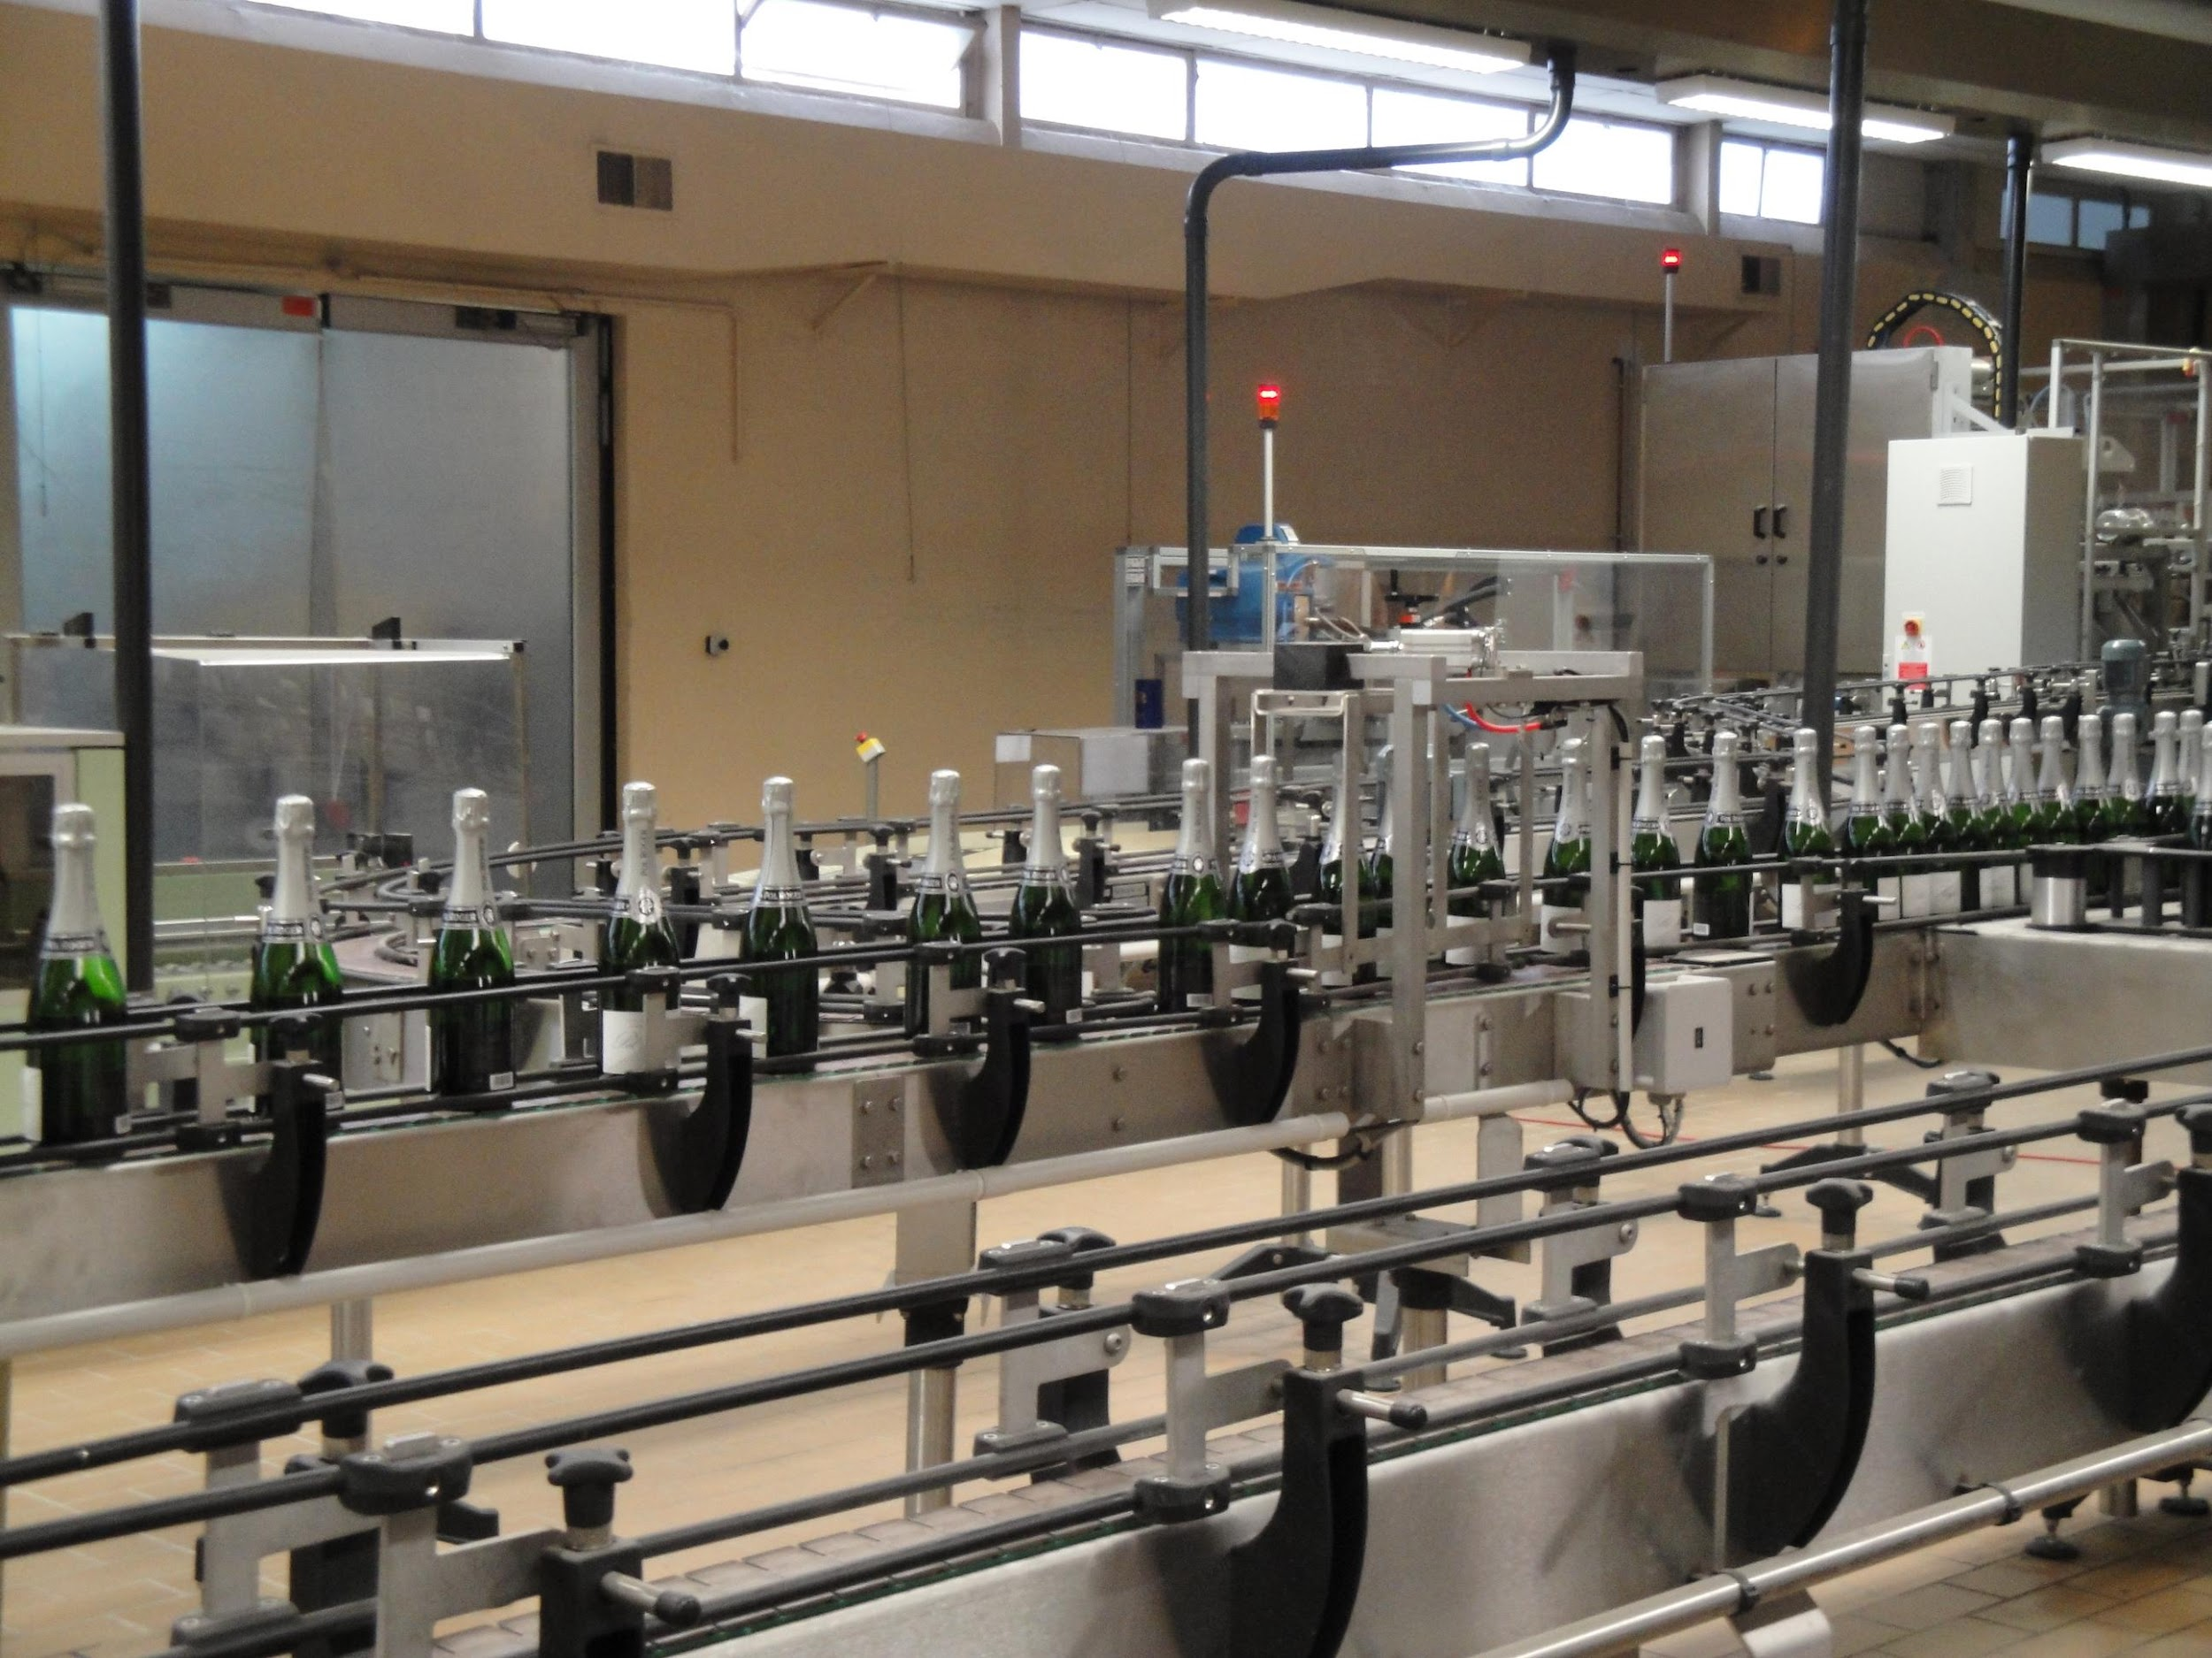
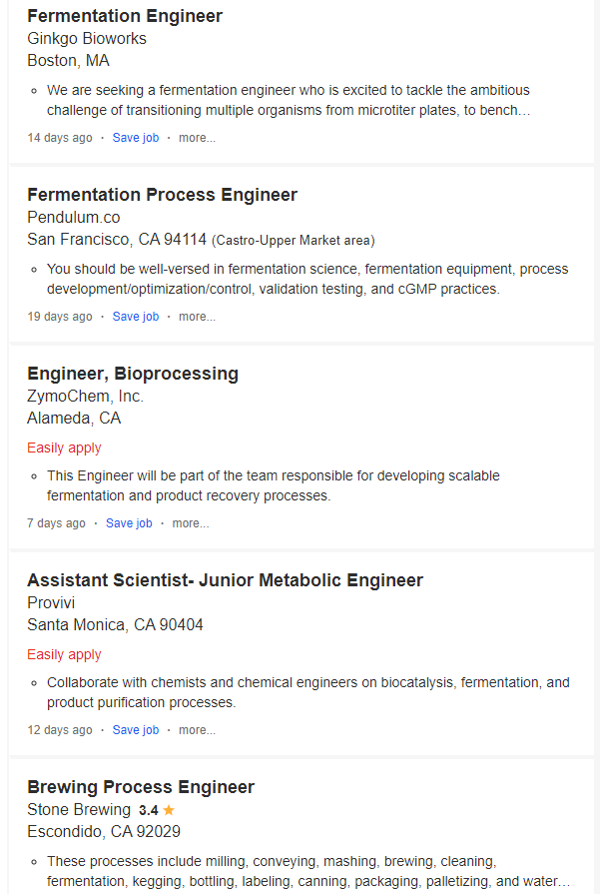
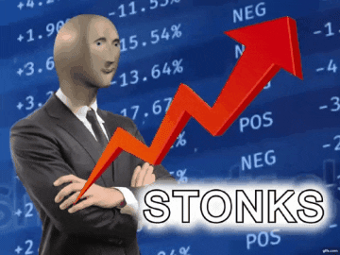
Bioresource Engineering Jobs
Notes:
Here are a few jobs that are available for bioresource engineering specializing in fermentation engineering. Some jobs may include tackling difficulties in upscaling a ferment from lab to pilot scale such setting up sensors to monitor the ferments condition to identify when the ferments issues arise. Developing fermentation technologies for satisfying a clients need to enhance their production, examples include mash tuns, fermentation tanks, kegging lines, bottling lines.

Slide 11
References
1) Puckette, M., & Hammack, J. (2018). Wine folly: the master guide. New York: Avery, an imprint of Penguin Random House.
2) US Department of Health and Human Services and US Department of Agriculture. 2015–2020 Dietary Guidelines for Americansexternal icon. 8th ed. Washington, DC: US Dept of Health and Human Services and US Dept of Agriculture; 2015.
https://www.indeed.com/jobs?q=Fermentation+Engineer+&l=
https://media1.giphy.com/media/YnkMcHgNIMW4Yfmjxr/giphy.gif?cid=790b761172eff95445b3d9529f1ded84a20cb03439cf6262&rid=giphy.gif

